Slide 1
Fiber broadband
For Paxton, MA

Slide 2
Matrix Design group / Millennium communications

Slide 3
Matrix and Millennium

Slide 4
Who Matrix Serves

Slide 5
Why We Are Here
Paxton Municipal Light Department hired Matrix to conduct a broadband feasibility study to help determine if a broadband solution is cost-effective and would add value to the residents of Paxton
Today we will review key takeaways from that study and answer questions

Slide 6
What Goes Into a Fiber Build?
Engineering, pole survey, fiber design, etc.
Utility Company Right of Way – Make-ready Process
Fiber Network Construction
Home / Business - Fiber Drop
Internet Service / Customer Service
Network Maintenance / Operations

Slide 7
Paxton, MA
Approximately 14.74 total square miles
Roughly 1,588 homes (United States Census)
Roughly 108 homes per square mile
Approximately 45 road miles (Paxton Master Plan)
Density of about 35 homes per road mile

Slide 8
Technical Feasibility
Mission: Develop a community wide broadband solution having the capabilities to facilitate the delivery of communications through several technology platforms. The infrastructure would require fiber optic cable as the medium for all signal transport to equipment demarcation points.

Slide 9
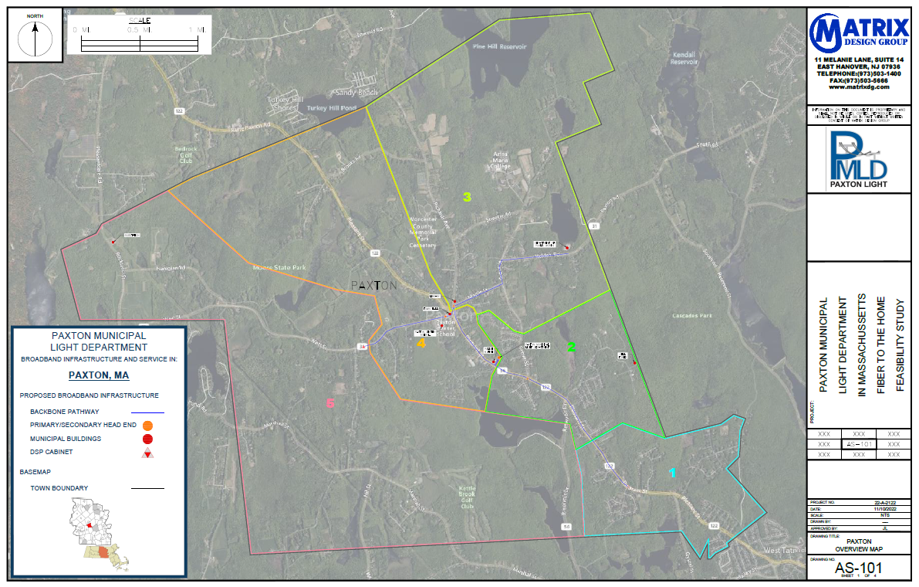
Technical Feasibility

Slide 10
High-Level Engineering
The design of the physical fiber transmissions & distribution plant determines the network’s future scalability and restricts how the plant is operated & maintained. The architecture is also the main determinant of the total cost of the deployment.

Slide 11
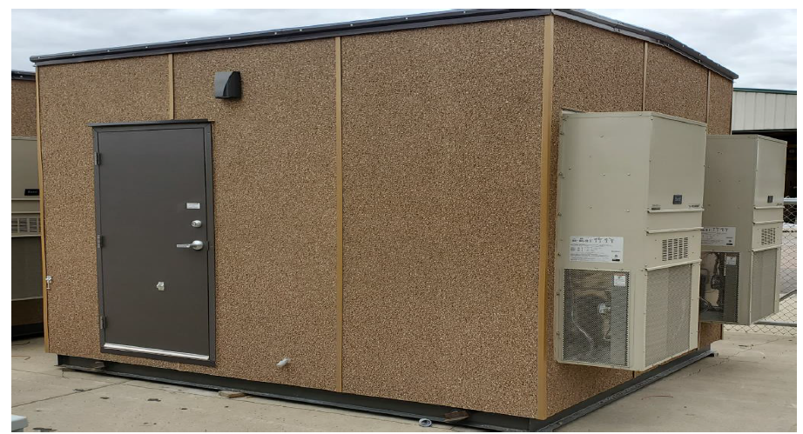
High-Level Material Overview

Slide 12
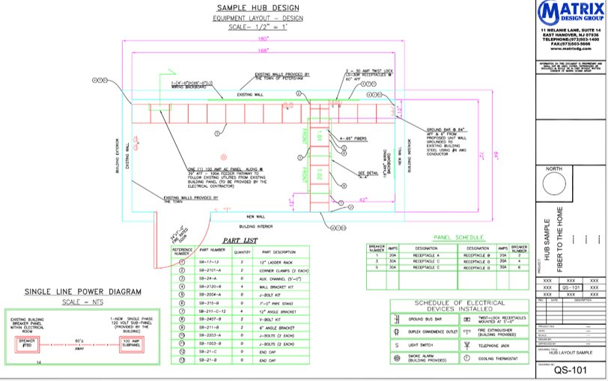
High-Level Material Overview

Slide 13
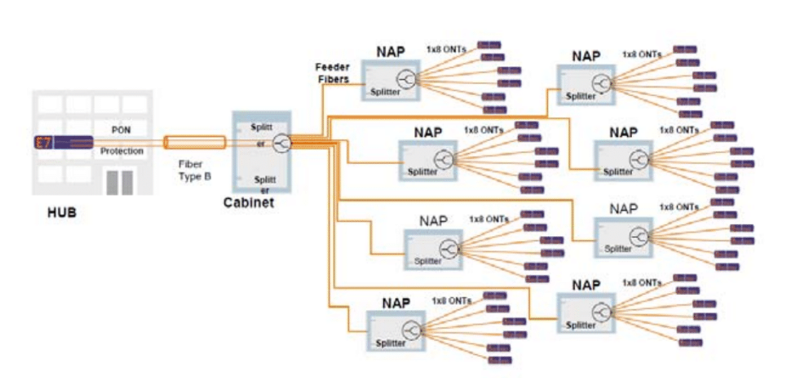
High-Level System Overview

Slide 14
High-Level Engineering

Slide 15
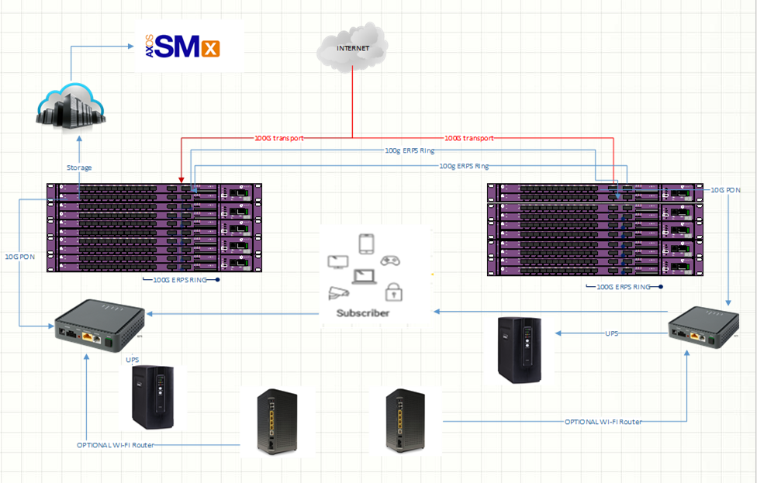
High-Level Material Overview

Slide 16
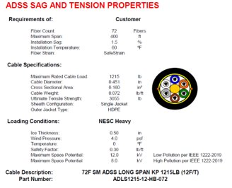
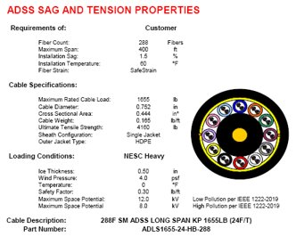
High-Level Material Overview

Slide 17
High-Level Material Overview

Slide 18
High-Level Engineering

Slide 19
High-Level Engineering

Slide 20
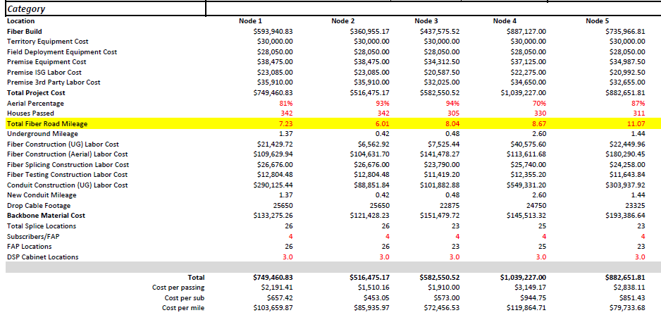
Financial Estimations

Slide 21
Questions / thank you!

